Slide 1




Automatic Model Generation from Documentation for Java API Functions
Juan Zhai, Jianjun Huang, Shiqing Ma, Xiangyu Zhang,
Lin Tan, Jianhua Zhao, Feng Qin

Slide 2
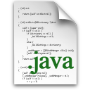

Motivation
Libraries
Part of software behaviors
As important as the software itself
Challenges
Binary only, no source code
Implemented in different languages
Complex optimizations
Many more…...
Previous works: generate models manually
App
Libs
Automatically Generate Models for Libraries

Slide 3

How to model library behaviors?
-Q: How do we know how to use libraries?
-A: By reading API documents.
-Q: Can we model libraries from API documents?
-A: Yes. This is what we do.
public void add(int index, E element)
Inserts the specified element at the specified position in this list.
Shifts the element currently at that position (if any),
and any subsequent elements to the right.
Throws:
IndexOutOfBoundsException: if the index is out of range (index<0||index>size())
public void add(int index, E elememt){
if(index<0 || index>size())
throw new IndexOutOfBoundsException();
size = size + 1;
for(int i=size-1; i>index; i--)
elements[i] = elements[i-1];
elements[index] = element;
}

Slide 4
Design: Overview
Text Analyzer
Tree Transformer
Syntactic Tree
Tree Variants
Javadoc
Model Validator
Model Generator

Slide 5
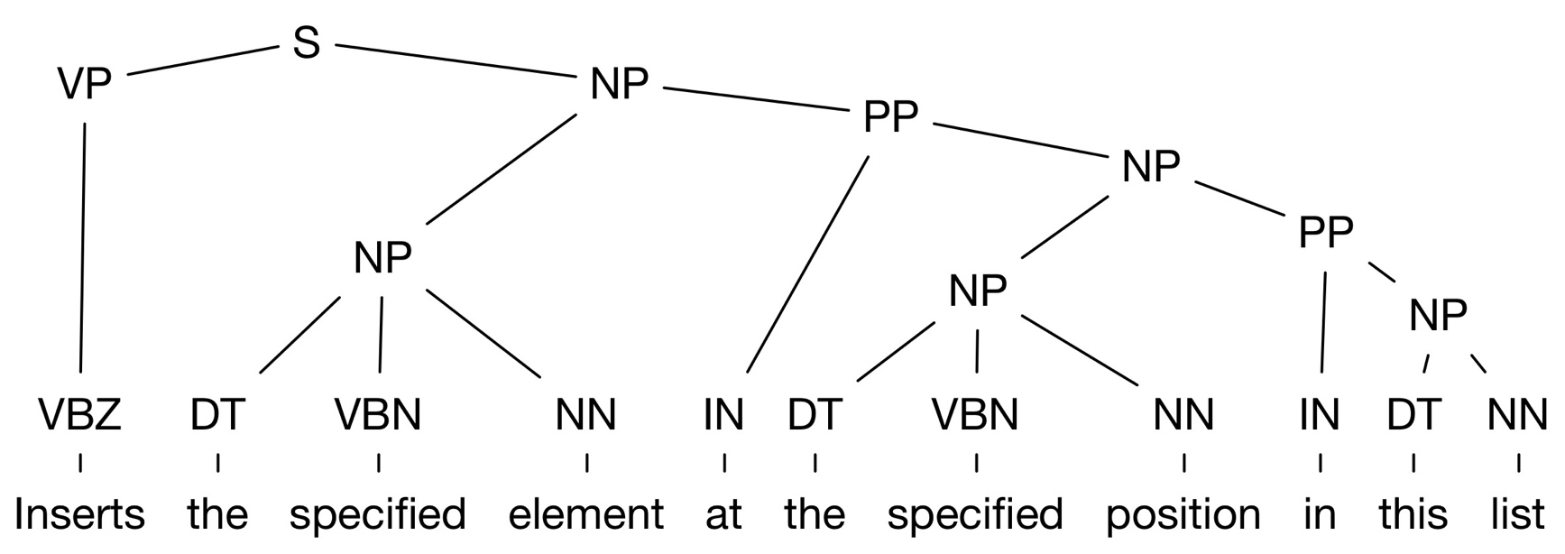
Design: Text Analyzer
State-of-the-art work: Stanford Parser
Not perfect because of the nature (e.g. ambiguity) of natural languages

Slide 6

Returns the head of this deque, or null if this deque is empty.
Returns
Lift Up
Returns
the head of
the head of
null if this deque is empty
this deque
null if this deque is empty
,or
this deque
,or
Returns the head of this deque,
OR returns the head of null if this deque is empty.
Returns the head of this deque,
OR returns null if this deque is empty.

Slide 7
Design: Tree Node Transformer
Ambiguities of natural languages
K tree candidates
Highest-scoring tree is not always the correct one
Too much time to try all candidates
Observation:
Caused by phrases starting with “, or” and “, and”
Solution:
Lift up & Push down “, ”, “or / and” and all their right siblings

Slide 8
Design: Generators
Javadoc
Formal Definition
Natural Language
Java code (Model)
Package, class, function metadata
Function body
Copy & Paste
IR & Model generator
Variables, Structures, Operations

Slide 9

Design: IR Generator -- Variables
Internal variables: any names
Parameters: identify from documents
the specified $(word)
add(int index , E element)
Inserts the specified element at the specified position in this list.
Inserts element at index in this list.

Slide 10
Design: IR Generator -- Program structures
Sequential
Default
Loop structure
plurals
singular nouns modified by “each”
the first/last occurrence → indicate the loop iteration order
Conditional structure
if/when
otherwise

Slide 11
Design: Model Generator
Tile the IR (tree)
Tree Pattern
T
o
return
o1
,or
Returns
,or
(-)? is
empty
o2
o3
-1
tag:if
the index
(tag:t)
o1
the index
tag:ltr
this
of
o1
(tag:o2))
(-)?
contain
o2
L
R
of
o
tag:this
contain
tag:-
o
copy
o1
into
o2
throw
o1

Slide 12

Design: Model Generator
Unified data structure model: one-dimensional array
Primitive: tree pattern corresponds to a piece of code template
insert
insert
elements[o2] = o1
insert
o1
element
at
o2(tag:this)
at
index(tag:this)
elements[index] = element

Slide 13
Design: Model Generator
Tile the IR (tree)
int index1 = -1;
if(o == null){
for(int i=0; i<size; i++){
if(element[i] == null){
index1 = i;
break;
}
}
}else{
for(int i=0; i<size; i++){
if(o.equals(element[i])){
index1 = i;
break;
}
}
}
int index2 = -1;
if(o == null){
for(int i=0; i<size; i++){
if(element[i] == null){
index2 = i;
break;
}
}
}else{
for(int i=0; i<size; i++){
if(o.equals(element[i])){
index2 = i;
break;
}
}
}
T
Returns
,or
-1
tag:if
the index
tag:ltr
this
L
R
of
o
tag:this
contain
tag:-
o
L
R
if(index2 == -1) return -1;
else return index1;
T

Slide 14






Design: Model Validator
Randoop

Slide 15
Evaluation Setup
Hardware
CPU: Intel® i7-3770
RAM: 8GB
Operating system
Ubuntu 12.04

Slide 16
Evaluation: Overall Result
Class | # Total Methods | # Modeled Methods | %
ArrayList | 34 | 29 | 85.29%
Vector | 54 | 46 | 85.19%
Stack | 6 | 5 | 83.33%
ArrayDeque | 36 | 35 | 97.22%
LinkedList | 42 | 41 | 97.62%
HashMap | 28 | 23 | 82.14%
LinkedHashMap | 15 | 14 | 93.33%
HashSet | 13 | 12 | 92.31%
LinkedHashSet | 5 | 4 | 80.00%
AttributeList | 15 | 11 | 73.33%
RoleList | 14 | 9 | 64.29%
RoleUnresolvedList | 14 | 9 | 64.29%
StringBuffer | 54 | 40 | 74.07%
StringBuilder | 54 | 40 | 74.07%
Summary | 397 | 326 | 82.12%

Slide 17
Evaluation: Cases that Cannot be Handled
Incompleteness of API documents
add(int index, Object element) in AttributeList
lack of descriptions about the IndexOutOfBoundsException
Describe one primitive behavior with several sentences
insert(int index, Char[] str, int offset, int len) in StringBuffer
Inserts the string representation of a subarray of the str array argument into this sequence.
The subarray begins at the specified offset and extends len chars.
The characters of the subarray are inserted into this sequence atthe position indicated by index

Slide 18
Evaluation: Static Taint Analysis
Undesirable information flow
Compare paths found by using our model V.S. official JDK
Set up
Android: 96 apps
Sources: User input
Sinks: Internet, Log

Slide 19
Evaluation: Static Taint Analysis
Results
the same set of information leak warnings for both versions for almost all apps
except app com.yes123.mobile
Case: com.123yes.mobil
Our model - 16 paths V.S. JDK – 14 paths
Java Native Interface (JNI) function call: toArray(object[]) -> System.arrayCopy()

Slide 20
Evaluation: Static Taint Analysis
Efficiency improvement distribution
Maximum: ~50%
Average: ~16%

Slide 21
Evaluation: Dynamic Slicing
Our Models vs Naïve Models
Programs | Naïve Models |  | Our Models
 | Slice Size | Time | Slice Size | Time
SPECJBB | 564 | 1.76 | 393 | 0.73
FunkyJFilter | 629 | 2.18 | 5 | 2.16
ListAppend | 7050 | 1279 | 504 | 5.9
Batik | 35721 | 1973.65 | 5516 | 295.77
Unit Test | 32 | 0.39 | 3 | 0.36
~32 times smaller dynamic slice size
~17% performance improvement

Slide 22
Related Work
Documentation Analysis
Sarah[ICSE ‘16], Zhong [OOPSLA ’13, ASE ’09], Tan [ICST ’12, ICSE ’11, SOSP ’07] , Pandita [ICSE ’12], Sun [ICSE ’10], Sinha [ICST ’10], Runeson [ICSE ’07] , Henkel [TSE ’07]
Environment Modeling
Jeon[ICSE ‘16], Merwe [SEN ’15], Ceccarello [SEN ’14], Palepu [ASE ’13], Qi [WCRE ’12], Cadar [OSDI ’08], Tkachuk [ASE ’03]

Slide 23
Conclusion
Idea: modeling Java library from Java API documents
A combination of NLP and auto-testing
Advantages
Expected behaviors with simpler code (no JNI code, no other languages etc.)
Helps many program analysis techniques

Slide 24



